Slide 1

Compiler Construction

Slide 2

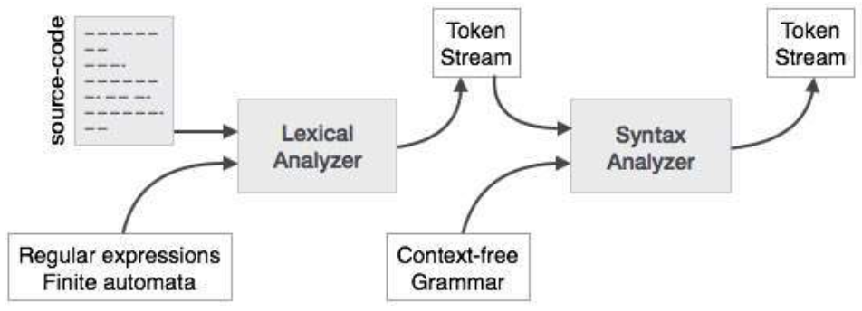

Slide 3

Parsing is the process of analyzing a text or a sequence of symbols according to the rules of a formal grammar. It is often used in computer science and linguistics to analyze and understand the structure of a sentence or a program.
It involves breaking down the code into individual components, such as statements, functions, and variables, and checking that the syntax is correct according to the rules of the programming language.
Overall, parsing is a fundamental process for understanding the structure and meaning of language and code.

Slide 4

Performs parsing with any grammar.
Hence, so called universal parsers.
They use parsing algorithms such as Cocke-, Younger-, Kasami-algorithm or Earley’s algorithm.
This method is insufficient, so they are not used any more on commercial basis

Slide 5

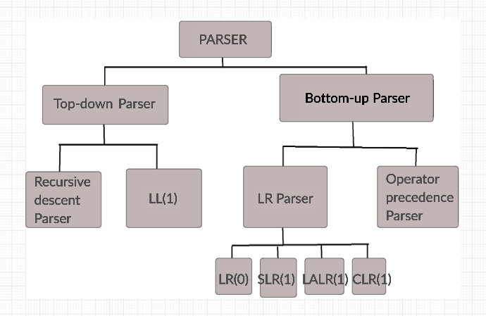

Slide 6

A top-down parser is a type of parsing algorithm that starts from the highest-level, or most general, grammatical structure of a language and works its way down to the individual words and symbols.

Slide 7

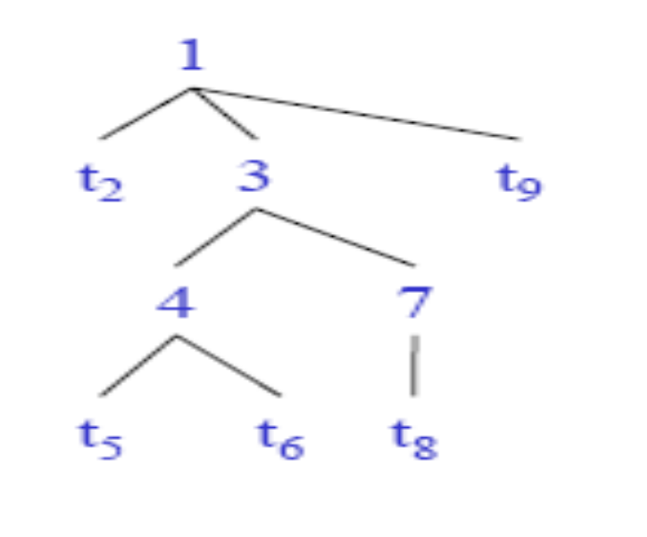
The parse tree is constructed
– From the top
– From left to right
• Terminals are seen in order of
appearance in the token stream:
t2 t5 t6 t8 t9

Slide 8

  Recursive-Descent Parsing
    Backtracking is needed (If a choice of a production rule does not work, we backtrack to try other alternatives.)
    It is a general parsing technique, but not widely used.
    Not efficient
  Predictive Parsing
    no backtracking
    efficient
    needs a special form of grammars (LL(1) grammars).
      Non-Recursive (Table Driven) Predictive Parser is also known as LL(1) parser.
      Recursive Predictive Parsing is a special form of Recursive Descent parsing without backtracking.
Notes:
lec03-topdownparser

Slide 9

Also known as Brute Force Technique
A non-terminal is always expanded with the first alternative only
That is first time, first rule
Same procedure is repeated for the newly expanded string
This process continues until it achieves a string of terminals
Once the nonterminal gets the string of terminals, it compares it with the input string; if it’s a match, it announces successful completion
Otherwise, it backtracks and tries the second alternative.
If it too do not match, it backtracks to the next level and repeats the same procedure until all combinations are verified.

Slide 10

Backtracking is needed.
It tries to find the left-most derivation.
S → aBc
B → bc | b
S S
Input : abc
a B c a B
b c b
fails, backtrack
c

Slide 11

Consider the grammar
E → T + E | T
T → ( E ) | int | int * T
Input: int * int
Start with top-level non-terminal E
Try the rules for E in order

Slide 12

Try E → T + E
Then try a rule for T → ( E )
But ( does not match input token int.
Try T → int . Token matches.
But + after T does not match input token *
Try T → int * T
This will match but + after T will be unmatched
Has exhausted the choices for T
Backtrack to choose for another derivation of E

Slide 13
Try E → T
Follow same steps as before for T
– And succeed with T → int * T and T → int
– With the following parse tree
E
T
int
T
*
int

Slide 14

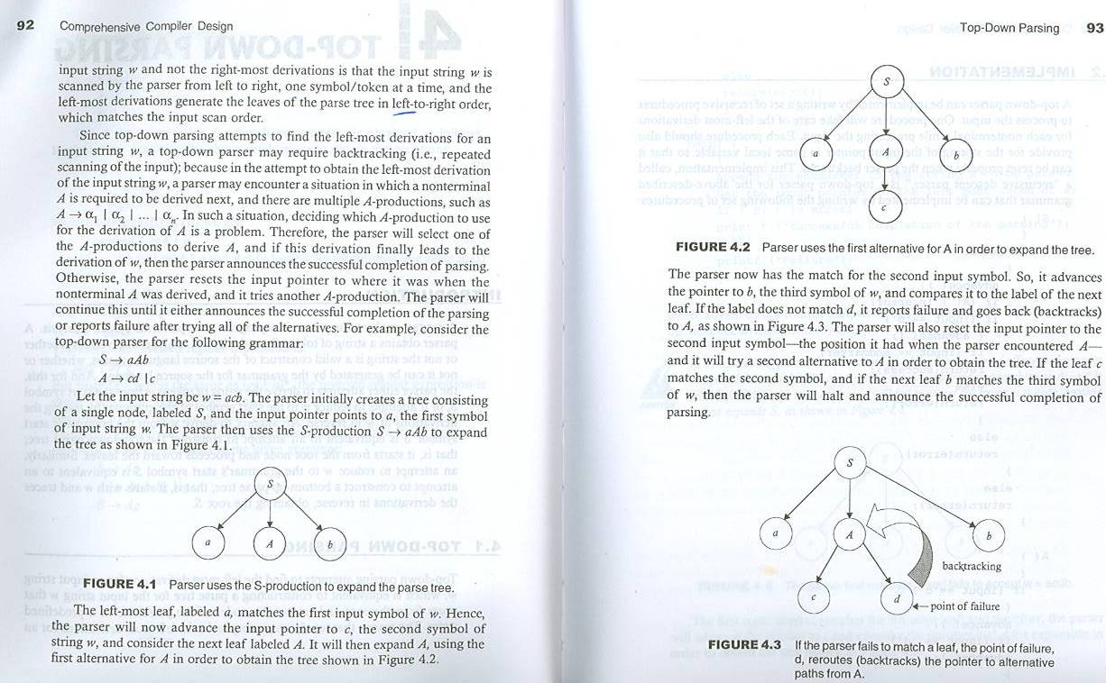
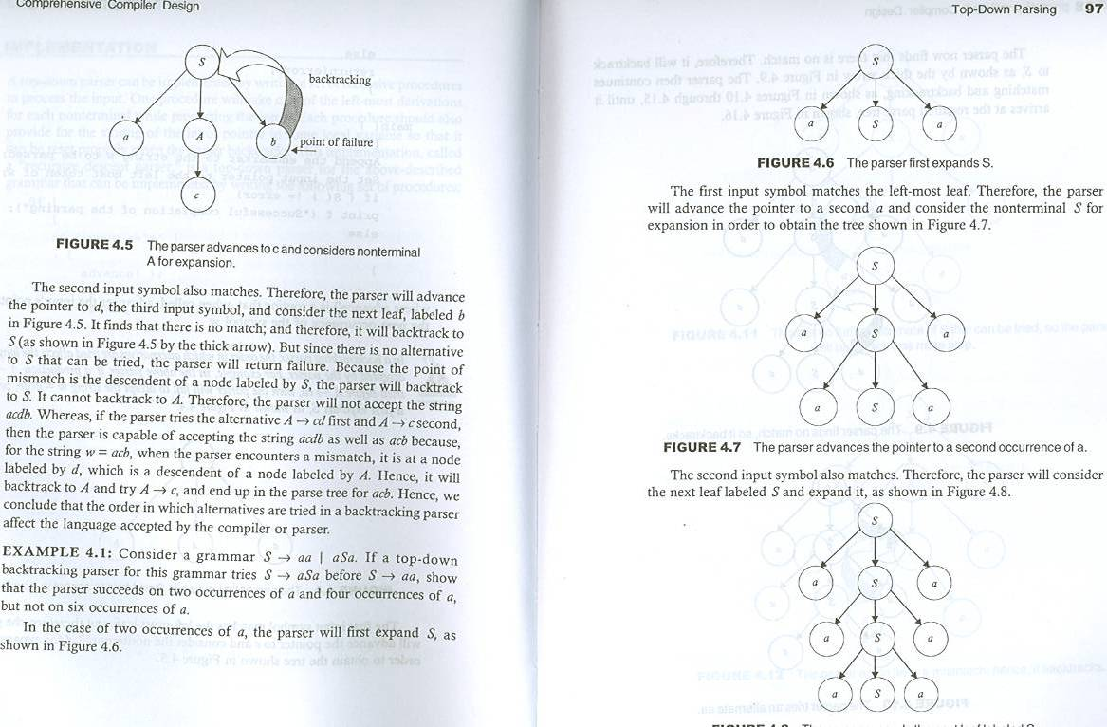
Consider the following production
S → aAb
A → c |cd
Let the input string be acdb.

Slide 15

Consider the following production
S→BA| AB
A→a| SA
B→b | SB
w= abab
Parse the above w using recursive decent parsing and find the problem of recursive decent parser

